Slide 1
Class Ten – Object Oriented Programming
Classes, References vs. Values, Static types and methods

Slide 2
Recall: data types
data type: A category of data values.
Example: integer, real number, string
Java data types are divided into two sets:
primitive types: Java's 8 built-in simple data types for numbers, text characters, and logic.
boolean, char, byte, short, int, long, float, double
object types: All other types!
e.g., Scanner, System, String, Math

Slide 3
Object Types
So far, we have seen:
variables, which represent data (categorized by types)‏
methods, which represent behavior
object: An variable that contains data and behavior.
There are variables inside the object, representing its data.
There are methods inside the object, representing its behavior.
class:
Basic building block of Java programs (what we have seen so far)‏
AND
Data types for objects

Slide 4


Object Oriented Programming
Notes:
Concept behind object oriented programming?

Slide 5
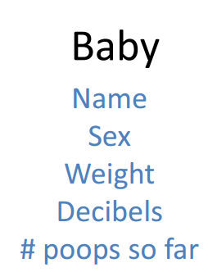
Object Oriented Programming

Slide 6
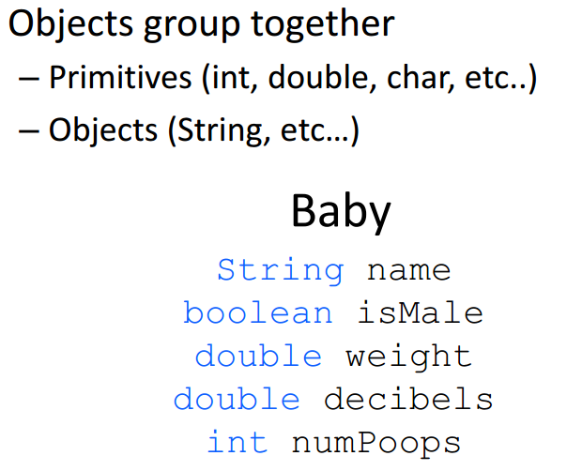
Object Oriented Programming

Slide 7
Object Oriented Programming

Slide 8
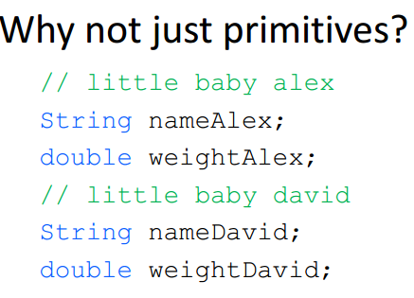
Why use classes?

Slide 9
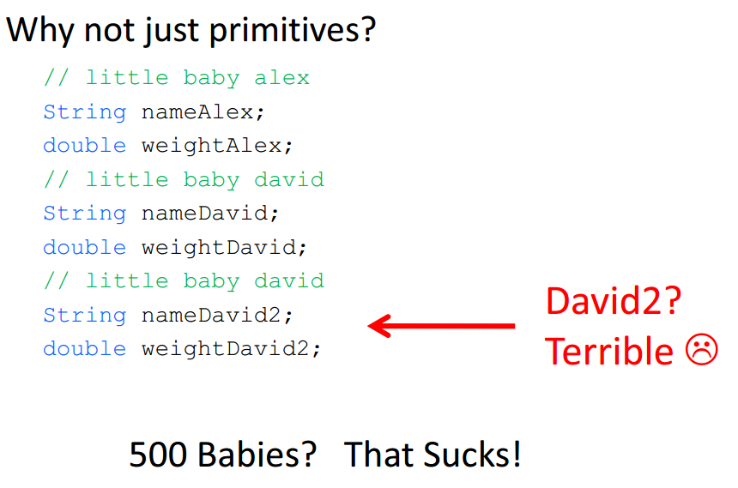
Why use classes?

Slide 10
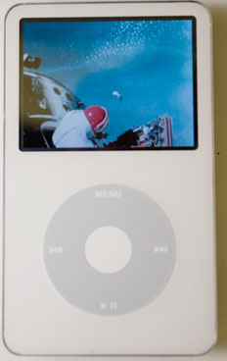
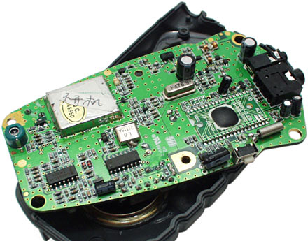
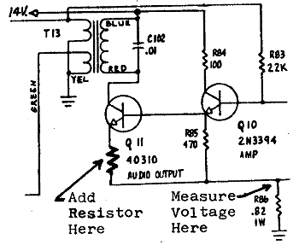
Big idea: Abstraction
abstraction: A distancing between ideas and details.
How do objects provide a level of abstraction?
You use abstraction every day!
Do YOU know how your iPod works?
?
?
?
?
?

Slide 11

Classes are like blueprints
Baby class blueprint
state: name. weight, decibels, numPoops, gender, etc.
behavior: sayHi, eat, poop,
Baby One
state: name. weight, decibels, numPoops, gender, etc.
behavior: sayHi, eat, poop,
Baby Two
state: name. weight, decibels, numPoops, gender, etc.
behavior: sayHi, eat, poop,
Baby Three
state: name. weight, decibels, numPoops, gender, etc.
behavior: sayHi, eat, poop,

Slide 12
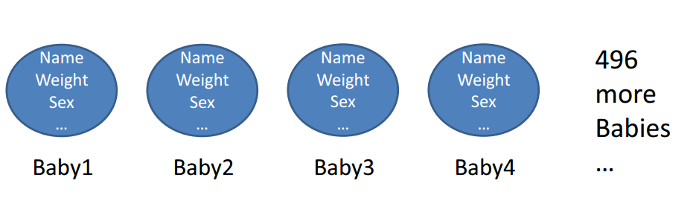
Why use classes?

Slide 13
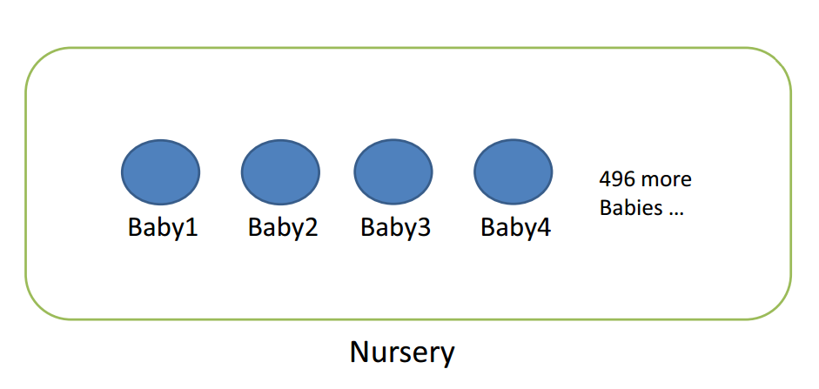
Why use classes?

Slide 14
Why use classes?

Slide 15
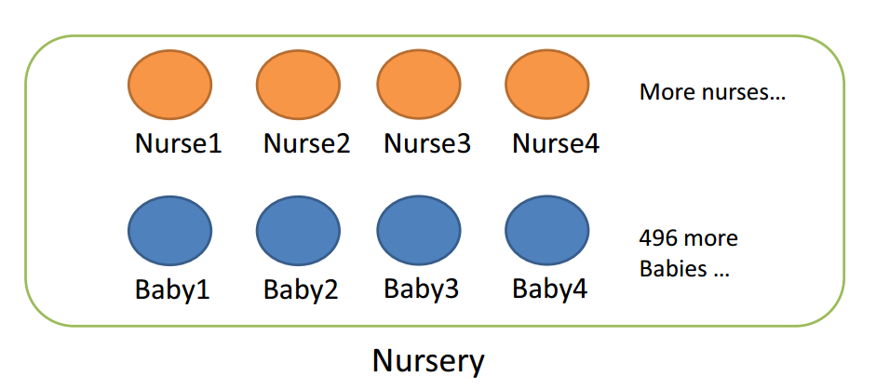
Why use classes?

Slide 16
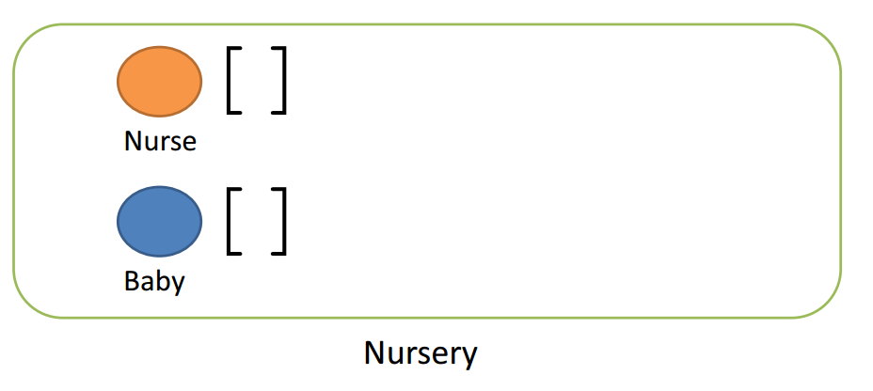
Why use classes?

Slide 17
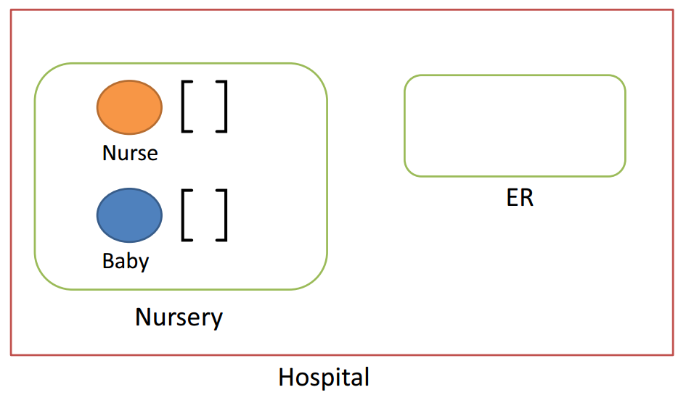
Why use classes?

Slide 18
Defining Classes

Slide 19
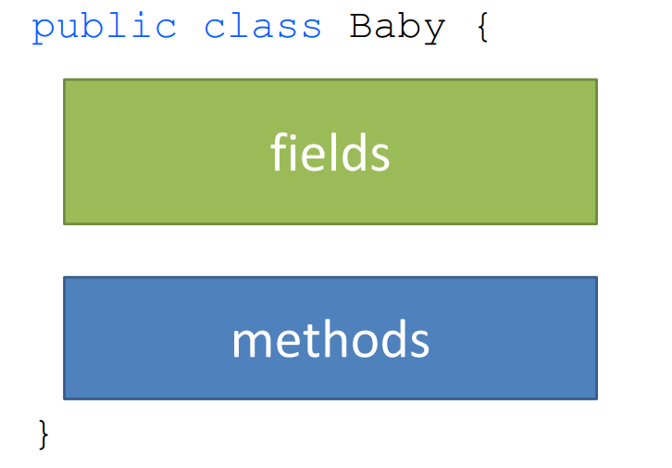
Let’s make a baby!

Slide 20
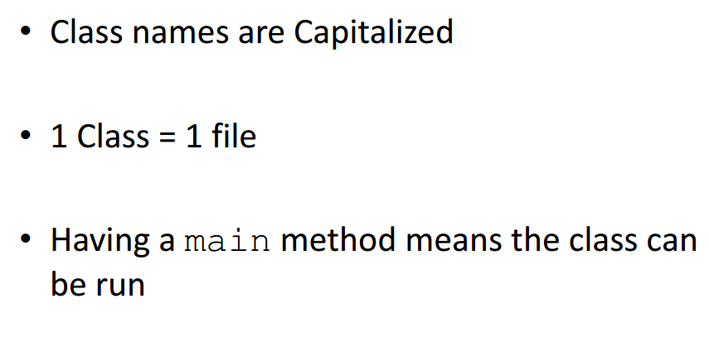
When defining classes, remember…

Slide 21
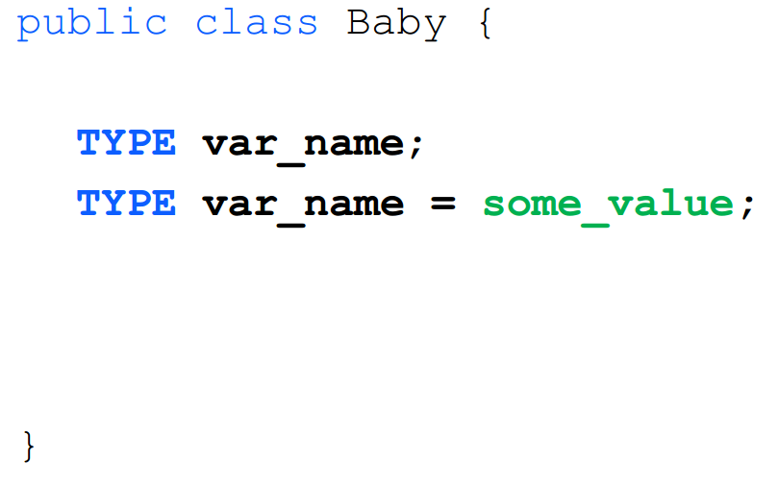
Class fields

Slide 22
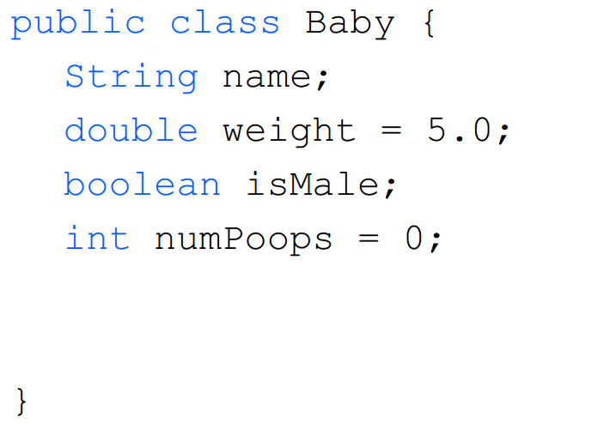
Class fields

Slide 23

Class fields – add a field?
//Add a list of siblings that are babies?

Slide 24
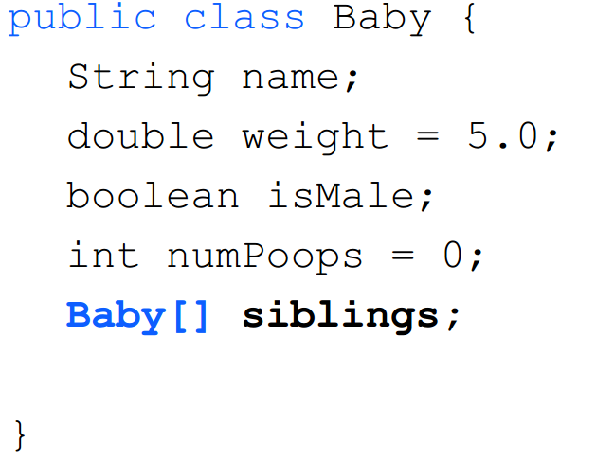
Class fields – add a field?
//Add a list of siblings that are babies?

Slide 25

Class – how do you make a baby?
This is like making any other object:
ObjectType name = new ClassType();
String name = new String(“Denzil”);
Scanner list = new Scanner(System.in);
ArrayList list = new ArrayList();

Slide 26
Class – what about name? gender?

Slide 27
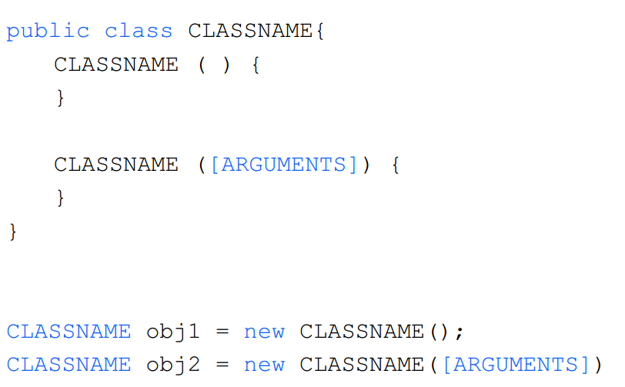
Class – Constructors
Notes:
One way to do this is with something called a constructor. This is a method you can use to set initial values for field variables. When the object is created, Java calls the constructor first. Any code you have in your constructor will then get executed. You don't need to make any special calls to a constructor method - they happen automatically when you create a new object.
Constructor methods take the same name as the class.

Slide 28
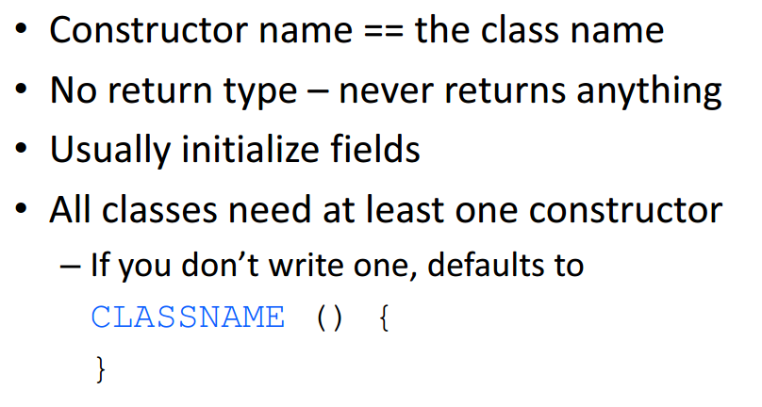
Class – Constructors
Notes:
One way to do this is with something called a constructor. This is a method you can use to set initial values for field variables. When the object is created, Java calls the constructor first. Any code you have in your constructor will then get executed. You don't need to make any special calls to a constructor method - they happen automatically when you create a new object.
Constructor methods take the same name as the class.
In our classes so far, the default constructor that does nothing is happening.

Slide 29
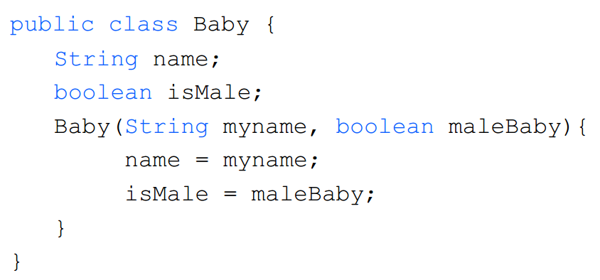
Class – Constructors

Slide 30
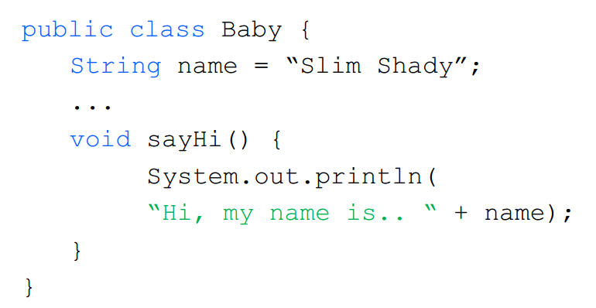
Class – Methods

Slide 31
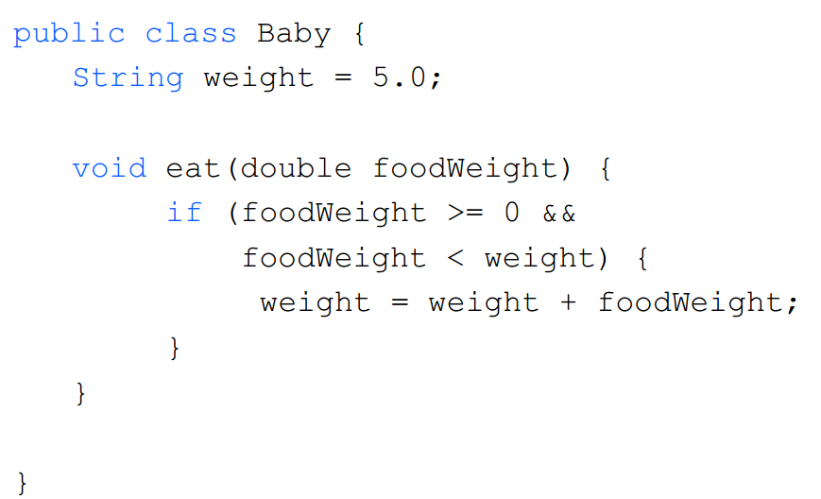
Class – Methods

Slide 32
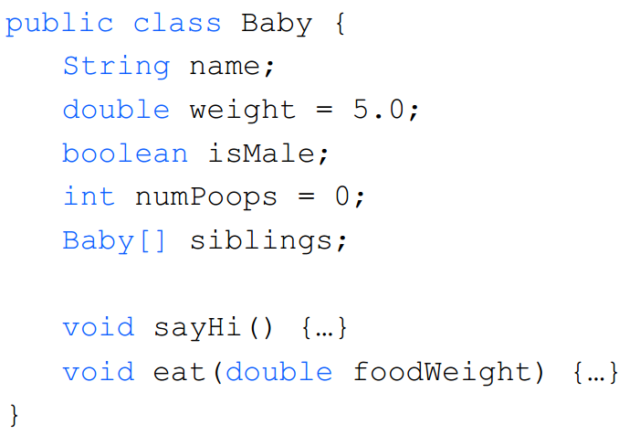
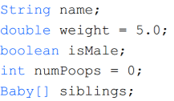
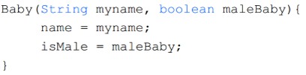

Class – Methods

Slide 33
Overloading Methods and Constructors
Two or more methods in a class may have the same name as long as their parameter lists are different.
When this occurs, it is called method overloading. This also applies to constructors.
Method overloading is important because sometimes you need several different ways to perform the same operation.

Slide 34
Overloaded Method add
public int add(int num1, int num2)
{
int sum = num1 + num2;
return sum;
}
public String add (String str1, String str2)
{
String combined = str1 + str2;
return combined;
}

Slide 35
Method Signature and Binding
A method signature consists of the method’s name and the data types of the method’s parameters, in the order that they appear. The return type is not part of the signature.
add(int, int)
add(String, String)
The process of matching a method call with the correct method is known as binding. The compilier uses the method signature to determine which version of the overloaded method to bind the call to.
Signatures of the add methods of previous slide

Slide 36
Class – Constructors

Slide 37
BankAccount Example
BankAccount
-balance:double
+BankAccount():
+BankAccount(startBalance:double):
+BankAccount(strString):
+deposit(amount:double):void
+deposit(str:String):void
+withdraw(amount:double):void
+withdraw(str:String):void
+setBalance(b:double):void
+setBalance(str:String):void
+getBalance():double
Overloaded Constructors
Overloaded deposit methods
Overloaded withdraw methods
Overloaded setBalance methods

Slide 38
public class BankAccount {
private double balance; // Account balance
public BankAccount() {
balance = 0.0;
}
public BankAccount(double startBalance) {
balance = startBalance;
}
public BankAccount(String str) {
balance = Double.parseDouble(str);
} …. ….
}

Slide 39
public class BankAccount {
private double balance; // Account balance
…. ….
public void deposit(double amount) {
balance += amount;
}
public void deposit(String str) {
balance += Double.parseDouble(str);
}
}

Slide 40
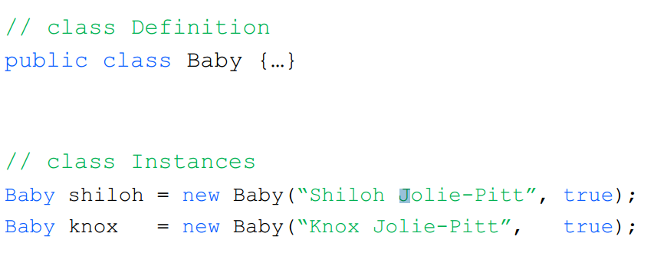
Classes & Instances
Baby jane = new Baby (true);

Slide 41



if(isMale)
name = “John Doe”;
else
name = “Jane Doe”;

Slide 42
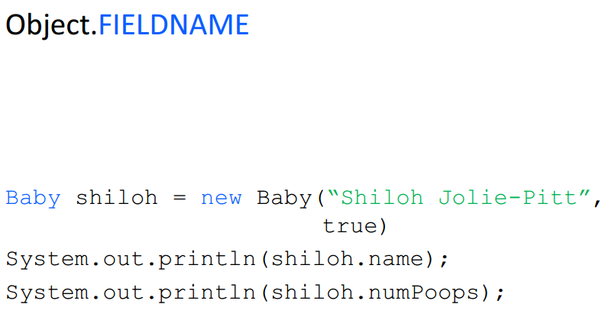
Class – Accessing Field

Slide 43
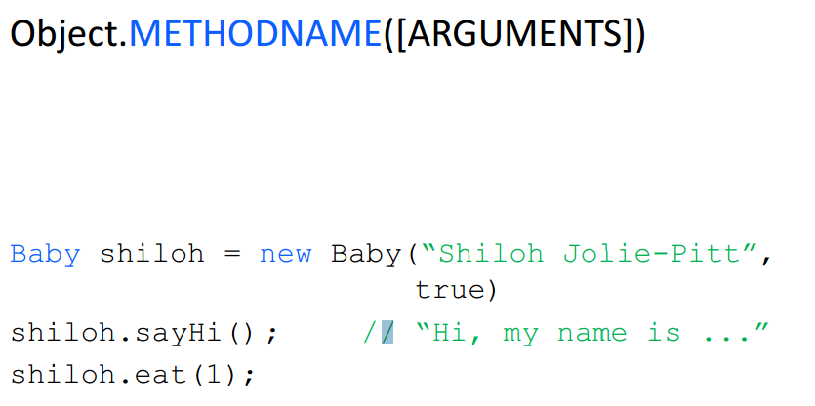
Class – Calling Methods

Slide 44
Let’s take an example from a Java Class!

Slide 45
Point Class
Data stored in each Point object:
Useful methods in each Point object:
Field name
Description
x
the point's x-coordinate
y
the point's y-coordinate
Method name
Description
distance(p)‏
how far away the point is from point p
setLocation(x, y)‏
sets the point's x and y to the given values
translate(dx, dy)‏
adjusts the point's x and y by the given amounts

Slide 46
Point class
Point class
state: int x, y
behavior: distance(Point p) equals(Point p) setLocation(int x, int y) toString() translate(int dx, int dy)‏
Point object #1
state: int x, y
behavior: distance(Point p) equals(Point p) setLocation(int x, int y) toString() translate(int dx, int dy)‏
Point object #2
state: int x, y
behavior: distance(Point p) equals(Point p) setLocation(int x, int y) toString() translate(int dx, int dy)‏
Point object #3
state: int x, y
behavior: distance(Point p) equals(Point p) setLocation(int x, int y) toString() translate(int dx, int dy)‏

Slide 47
Using Point objects: Example
To use the Point class, you have to import it from the java.awt package in Java.
import java.awt.*;
public class PointMain {
public static void main(String[] args) {
// construct two Point objects
Point p1 = new Point(7, 2);
Point p2 = new Point(4, 3);
// print each point and their distance apart
System.out.println("p1 is " + p1);
System.out.println("p2: (" + p2.x + ", " + p2.y + ")");
System.out.println("distance = " + p1.distance(p2));
// translate the point to a new location
p2.translate(1, 7);
System.out.println("p2: (" + p2.x + ", " + p2.y + ")");
System.out.println("distance = " + p1.distance(p2));
}
}

Slide 48
References vs. Values

Slide 49
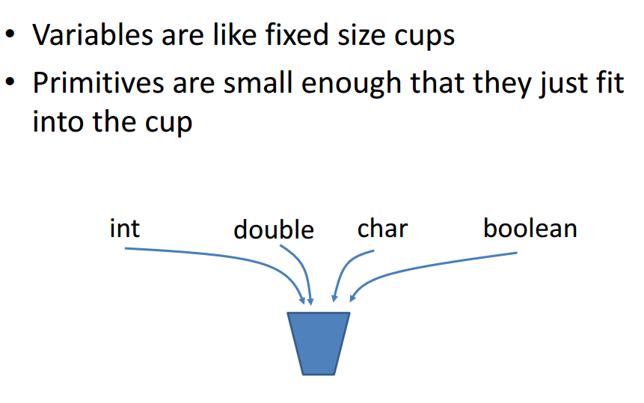
How Java stores primitives

Slide 50
Representing objects
Let’s pretend we imagine primitive types in memory like this:
int x = 7;
7
X:

Slide 51
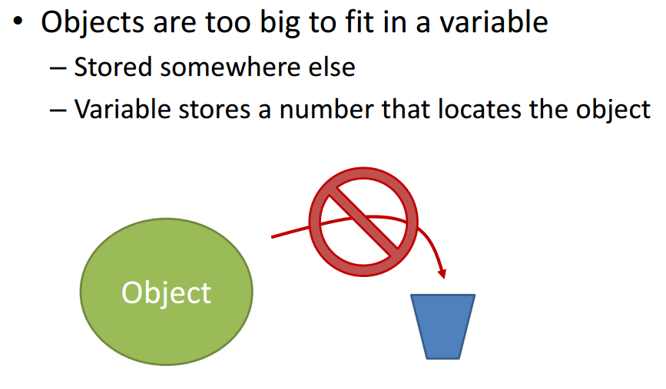
How Java stores objects

Slide 52
Representing objects
Then we would represent object types like this:
Point p = new Point(7,3);
Fields
x:
y:
p:
7
3
Variable, with slot in memory
Reference, a pointer to the object’s data
Data, in another part of memory

Slide 53
References
Object variables are references to the location in memory where their data resides.
We draw references as pointers.
Actually, p stores the address of the location in memory where its data is.
Fields
x:
y:
p:
7
3
Variable, with slot in memory
Reference, a pointer to the object’s data
Data, in another part of memory

Slide 54
Constructing an object
What happens when the following call is made?
Point p1 = new Point(7, 2);
p1:
x:
7
y:
2

Slide 55
null objects
null is a value for all object types that says,
“this object is a reference to nothing at all”
Note that null objects have no memory reserved for their data!
Point p1 = null;
p1:

Slide 56
Value vs. reference semantics

Slide 57
Value semantics
value semantics: Behavior where variables are copied when assigned to each other or passed as parameters.
Primitive types in Java use value semantics.
Modifying the value of one variable does not affect other.
Example:
int x = 5;
int y = x; // x = 5, y = 5
y = 17; // x = 5, y = 17
x = 8; // x = 8, y = 17

Slide 58
Reference semantics
reference semantics: Behavior where variables refer to a common value when assigned to each other or passed as parameters.
Object types in Java use reference semantics.
Object variables do not store an object; they store the address of an object's location in the computer memory. We graphically represent addresses as arrows.
Example:
Point p1 = new Point(3, 8);
p1
x:
3
y:
8

Slide 59
Reference semantics
If two object variables are assigned the same object, the object is NOT copied; instead, the object’s address is copied.
As a result, both variables will point to the same object.
Calling a method on either variable will modify the same object.
Example:
Point p1 = new Point(3, 8);
Point p2 = p1;
p2.setLocation(1, 2);
3
8
p1
x:
1
y:
2
p2

Slide 60
Reference semantics: Why?
Objects have reference semantics for several reasons:
efficiency: Objects can be large and bulky. Having to copy them every time they are passed as parameters would slow down the program.
sharing: Since objects hold important state, it is often more desirable for them to be shared by parts of the program when they're passed as parameters. Often we want the changes to occur to the same object.

Slide 61
Reference semantics: Example
Point p1 = new Point(3, 8);
Point p2 = new Point(2, -4);
Point p3 = p2;
How many unique objects are there? How do you know that?
Two, because objects are only created with the new keyword.
If we change p3, will p2 be affected and vice versa?
Yes.
p1
x:
3
y:
8
p2
x:
2
y:
-4
p3

Slide 62
Reference semantics: Example
If two variables refer to the same object, modifying one of them will also make a change in the other:
p3.translate(5, 1);
System.out.println("(" + p2.x + " " + p2.y + ")");
Output:
(7, -3)‏
p1
x:
3
y:
8
2
-4
p2
x:
7
y:
-3
p3

Slide 63
How not test equality of objects
DO NOT DO THIS:
Point p1 = …;
Point p2 = …;
if(p1==p2) {
…
}
BAD

Slide 64
How not test equality of objects
Objects store references, or addresses.
Comparing two objects with == will test if they have the same address.
This is NOT what you want.
DO NOT DO THIS
Point p1 = …;
Point p2 = …;
if(p1==p2) {
…
}
BAD

Slide 65
Why so bad?
Point p1 = new Point(7, 2);
Point p2 = new Point(7, 2);
Is p1==p2 true or false?
It’s false: they point to different spots in memory. So they store different addresses.
But we want it to be true , obviously!
p1:
x:
7
y:
2
p2:
x:
7
y:
2

Slide 66
The equals method
All classes in Java have a built-in equals method
For the Point class:
p1.equals(p2)
This returns true if p1 and p2 have the same data
It doesn’t matter if they reference different locations in memory
Likewise, use !p1.equals(p2) instead of p1!=p2

Slide 67
Object and primitive types: a comparison (so far)
Object types | Primitive types
Constructed with the new keyword | Values don’t need to be constructed
References to memory location that stores their data | Store data directly in memory slot
Can be null (have no data) | Cannot be null
Can cause NullPointerExceptions | Cannot cause NullPointerExceptions
Contain state and behavior | Contain state only
Use reference semantics | Use value semantics
Use equals() method | Use ==, !=

Slide 68
Calling methods or fields on objects
Since the methods are bundled in the objects, calling these methods requires specifying which object we are talking to.
Calling a method or field of an object, general syntax:
<variable>.<method name>(<parameters>)‏
<variable>.<field name>
Examples:
String s1 = “Homey da Clown”;
String s2 = “Bubbles the clown”;
System.out.println(s1.length()); // prints 14
System.out.println(s2.length()); // prints 17
Point p = new Point(7, 3); // p = (7,3)
p.x = 2; // p = (2,3)
p.y = p.y + 10; // p = (2,13)
// displays “(2, 13)”
System.out.println(“(“ + p.x + “, “ + p.y + “)”);

Slide 69
Dereferencing
When we use the “.” operator on an object, we access the stuff (methods and/or data) that the object references (or points to).
This is called dereferencing.
The “.” operator is the dereferencing operator.

Slide 70
Three kinds of method calls
We have seen three ways to call methods:
Type: | No ‘.’ used | <class>.<method> | <variable>.<method>
When it’s used: | For methods defined in the same class as they’re called | For static methods defined in another class | For non-static or instance methods defined in another class
Examples: | myMethod(); | Math.max(a,b) | myString.length()
 |  | Integer.parseInt(“6”) | myScanner.next()

Slide 71
static types & other keywords

Slide 72
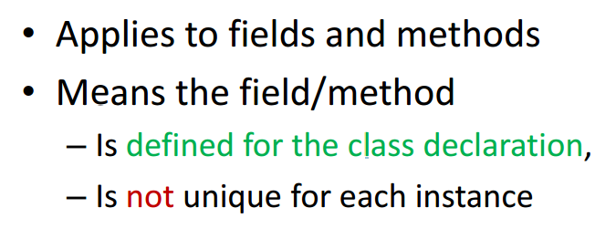
static
Notes:
There can be times when it's useful to have values that are shared across all instances of a particular class. Static fields enable this to happen by belonging to the class and not to the actual objects.
Normally fields and methods defined in a class can only be used when an object of that class type has been created.
However, if the static modifier is included in a field or method declaration, no instance of the class is required for it to be used. The field or method is associated with the class and not an individual object.
public class Baby { static int numBabiesMade = 0; } Baby.numBabiesMade = 100; Baby b1 = new Baby(); Baby b2 = new Baby(); Baby.numBabiesMade = 2;

Slide 73
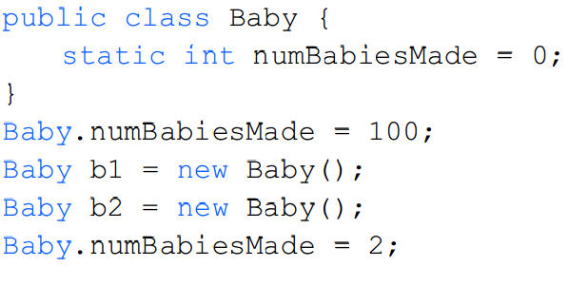
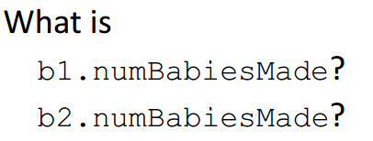
static
Notes:
The use of a static field means that each object does not need to know about the other objects to know the what number baby it is or how many babies in the world there are.
Static is also useful if we wanted to give each baby a unique id number based on when they were born.
public class Baby { static int numBabiesMade = 0; } Baby.numBabiesMade = 100; Baby b1 = new Baby(); Baby b2 = new Baby(); Baby.numBabiesMade = 2;

Slide 74

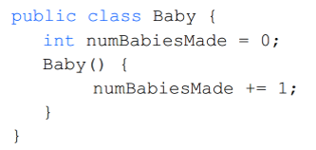
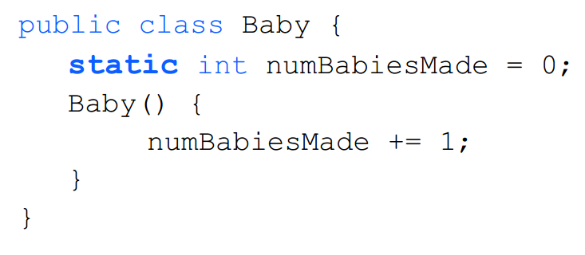
static field
What’s the difference?
Notes:
A value that is declared static has no associated instance. It exists for every instance, and is only declared in a single place in memory. If it ever gets changed, it will change for every instance of that class.

Slide 75
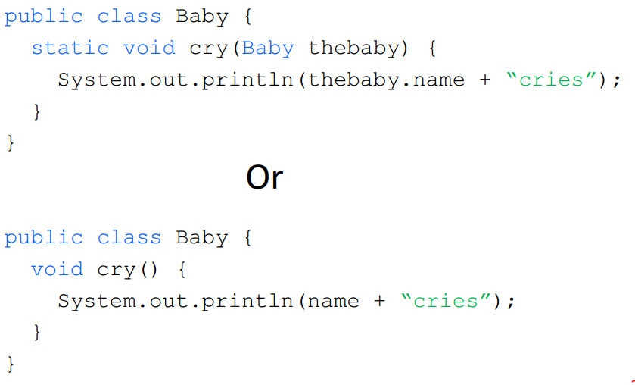
static method
What’s the difference?
Notes:
In most OO languages, when you define a method inside a class, it becomes an Instance Method. When you create a new instance of that class, via the new keyword, you initialize a new set of data unique to just that instance. The methods belonging to that instance can then work with the data you defined on it.
Static Methods, by contrast, are ignorant of individual class instances. The static method is similar to a free function in C or C++. It isn't tied to a specific instantiation of the class. This is why they cannot access instance values. There's no instance to take a value from!
Static Data is similar to a static method. A value that is declared static has no associated instance. It exists for every instance, and is only declared in a single place in memory. If it ever gets changed, it will change for every instance of that class.
A Static Method can access Static Data because they both exist independently of specific instances of a class.
a static method is capable of working with non-static data, but it must be passed explicitly.

Slide 76
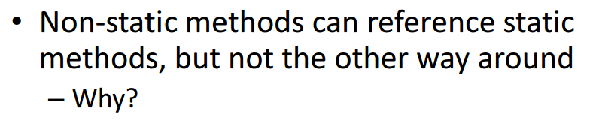
static vs. non-static
Notes:
Java is a Object Oriented Programming(OOP) language, which means we need an object to access any method or variable inside or outside the class. The one exception is static. This is so you can have objects that exist outside of classes, something that all instances of a class can share
We don’t want static methods to be referencing non-static items because non-static items are dependent on objects while the whole point of static is that they are independent of instances and will have consistent behavior and values for all non-static methods and data that references it.
You can't call something that doesn't exist. Since you haven't created an object, the non-static method doesn't exist yet. A static method (by definition) always exists.

Slide 77

main()
Why is main static?
Notes:
The public static void keywords mean the Java virtual machine (JVM) interpreter can call the program's main method to start the program (public) without creating an instance of the class (static), and the program does not return data to the Java VM interpreter (void) when it ends.
The method is static because otherwise there would be ambiguity: which constructor should be called? Especially if your class looks like this:
public class JavaClass{ protected JavaClass(int x){} public void main(String[] args){ } }Should the JVM call new JavaClass(int)? What should it pass for x?
If not, should the JVM instantiate JavaClass without running any constructor method? I think it shouldn't, because that will special-case your entire class - sometimes you have an instance that hasn't been initialized, and you have to check for it in every method that could be called.
There are just too many edge cases and ambiguities for it to make sense for the JVM to have to instantiate a class before the entry point is called. That's why main is static.

Slide 78
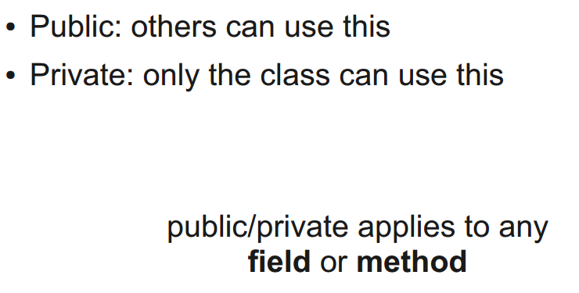
public vs. private
Notes:
What are we doing with these keywords? We controlling the access of information
It’s like protecting private information
Clarify how others should use your class

Slide 79
Scope Review
Variable exists within the curly braces where it was defined!
Previous classes – method-level scope or loop-level scope
This class – class-level scope!

Slide 80
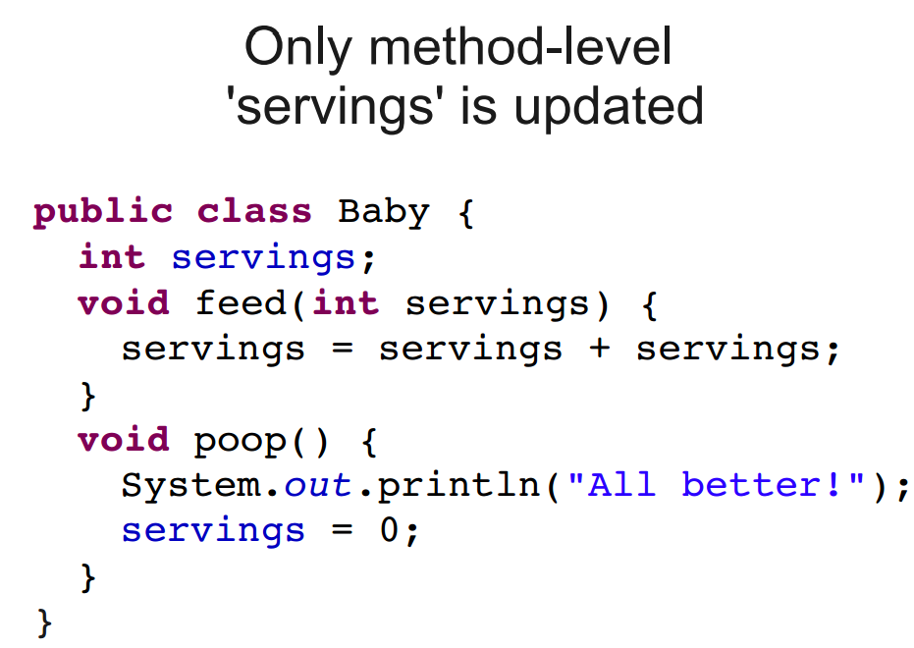
Method-Level vs Class-Level Scope

Slide 81
Method-Level vs Class-Level Scope

Slide 82
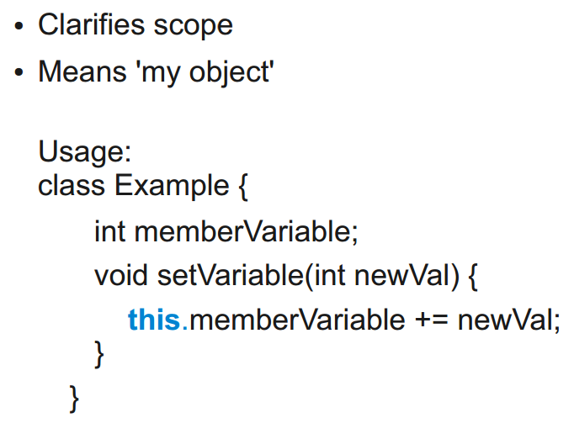
this keyword

Slide 83
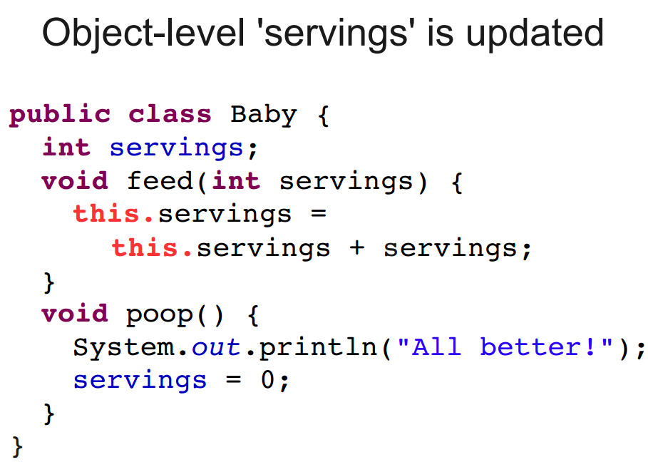
Method-Level vs Class-Level Scope

Slide 84
Packages
Each class belongs to a package
Classes in the same package serve a similar purpose
Packages are just directories
Classes in other packages need to be imported

Slide 85
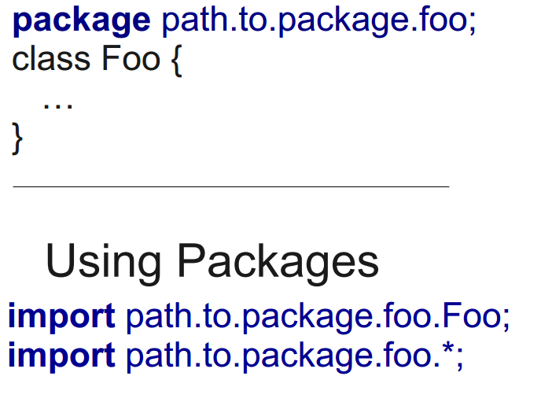
Packages

Slide 86
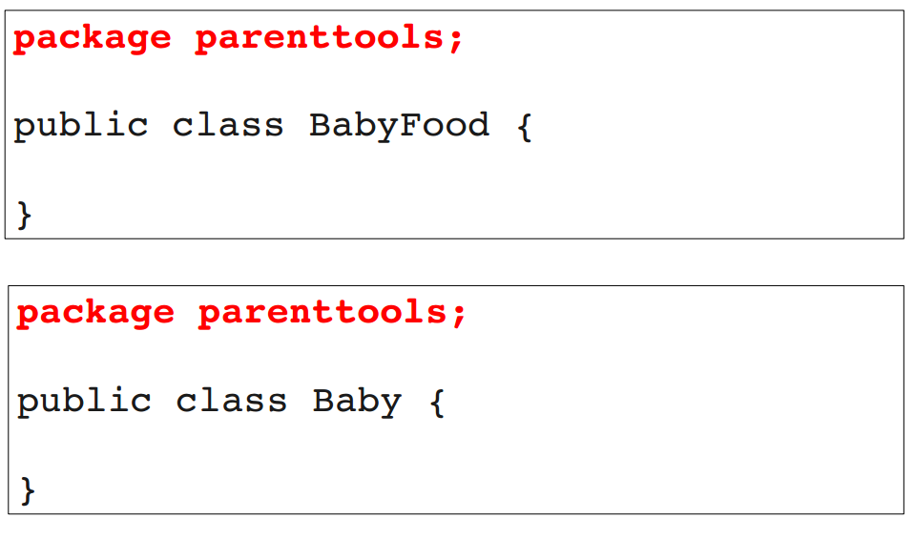
Packages

Slide 87
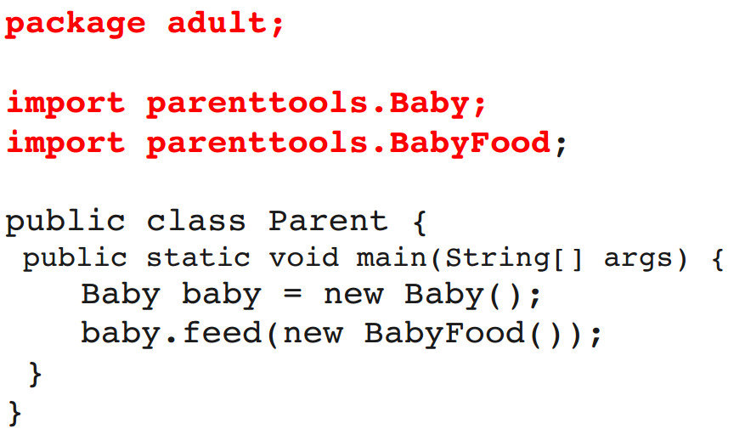
Packages
import parenttools.*;

Slide 88
Packages
Great for combining similar functionality
All classes “see” classes in the same package
Don’t need to import
All classes “see” classes in java.lang
So String class and the System class

Slide 89
Packages
Java has lots of packages/classes
We reuse classes to avoid extra work/duplicate code
http://docs.oracle.com/javase/8/docs/api/index.html

Slide 90
Java Interfaces
Manipulate objects without knowing how they work
Useful when you have similar but not identical objects
Useful when you want to use code written by others

Slide 91
Java Interfaces
Set of classes that share methods
Declare an interface with the common methods
Can use the interface, without knowing an object’s specific type

Slide 92
Java Interfaces
A class can implement any number of interfaces
An interface does not provide code, only the definition (called signatures)
When using an interface, can only access what’s inside that interface

Slide 93
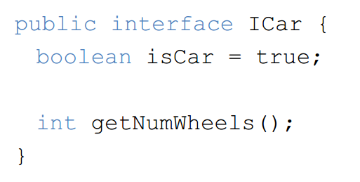
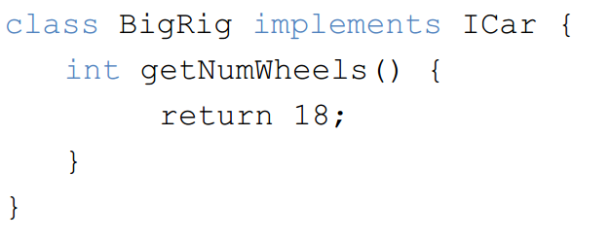
Interface Example

Slide 94
Interface Example
It’s a contract
If you utilize an interface, then you must implement all the methods
All fields are final (cannot be changed)

Slide 95
Next Time: Review for Final Fun with Graphics
Read up on graphics, try assignment:
http://docs.oracle.com/javase/8/docs/api/java/awt/Graphics.html

